Slide 1
VEHICLE ACCIDENT DETECTION SYSTEM
PRESENTED By : Naveen prasath. V(22ai031)
Prem kumar.R(22ai039)
Rajeshkanna.U.M(22ai049)
Guided By :Dr. K. Lalitha,
Professor,
Department of AI & DS,
Nandha Engineering College.
TEAM NO
22AIC14 – INTERNET OF THINGS AND ITS APPLICATIONS

Slide 2
Abstract
A Vehicle Accident Detection System is designed to detect vehicular accidents in real time and provide rapid response by alerting emergency services or relevant authorities. The system uses a combination of sensors, such as accelerometers, gyroscopes, GPS, and cameras, to monitor the vehicle's motion, speed, and impact forces. When an abnormal event, such as a sudden deceleration or collision, is detected, the system triggers an alert. The system can also include machine learning algorithms that analyze driving patterns to reduce false alarms. Once an accident is detected, the system can automatically send the vehicle's location, severity of impact, and possibly even the condition of the occupants to emergency responders, helping to reduce response time and potentially save lives. This technology can be integrated into modern vehicles or connected through mobile devices for added accessibility and convenience.

Slide 3
Objectives:
Automated Emergency Notification: Instantly alert emergency services or designated contacts with details such as the accident location, severity, and time.
Reduction of Response Time: Shorten the time between the accident and the arrival of emergency services, increasing the chances of saving lives.
Enhance Passenger Safety: By monitoring driving behavior, the system helps in the early detection of potential risks, preventing accidents or minimizing damage.
Accident Documentation: Provide accurate data for insurance purposes or accident analysis, such as the vehicle’s speed, braking patterns, and environmental conditions.

Slide 4
Components Required:
Arduino
GPS Module
GSM800A
Vibration sensor
Bread board

Slide 5
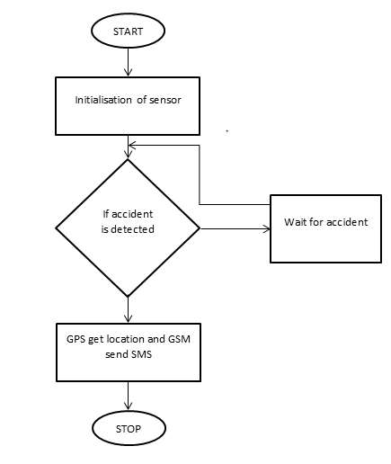
Flow Diagram:

Slide 6
Implementation: (Hardware or software)
.
GPS: Used to track the vehicle's position and send it to the rescue team
.
GSM: Used to send a message to the guardian and rescue team about the location of the accident
VIBRATION:Vibration sensor detects the heavy vibration within the vehicle.

Slide 7
LIMITATIONS:
1.Accuracy Issues
False positives (e.g., sharp turns misidentified as accidents) and false negatives (minor accidents missed).
2.Hardware Constraints
Sensor failures and power disruptions can hinder detection.
3.Connectivity Dependence
Requires strong network/GPS connectivity for real-time reporting.
4.Cost and Maintenance
High installation and maintenance costs limit accessibility.

Slide 8
FUTURE ENHANCEMENTS:
1.AI Integration for Better Accuracy
Use machine learning algorithms to reduce false positives and false negatives by analyzing diverse accident scenarios.
2.Enhanced Sensor Technology
Incorporate advanced sensors like LiDAR, thermal imaging, and improved accelerometers for precise accident detection.
3.Real-time Data Sharing
Enable direct communication with nearby vehicles and emergency services
through Vehicle-to-Everything (V2X) technology.

Slide 9
THANKYOU

